Slide 1
Heineken FX rate automation:
Purpose:
Create an automation tool, to load exchange rates from different sources and compare with target System with respect to datetime.
Source can be either third party service(Bloomberg, Non-Bloomberg) or manual maintenance.
Allow user to manually maintain data

Slide 2

Architecture:
to synchronize data
between microservices
Web Servlet
Establishes connection to Hana db using JDBC,
Exposes as REST API.
SAP CLOUD PLATFORM
consume Exposed REST Service and bind data to UI.
Fx rate Microservice
Fx Store
(SAP UI5)
Fiori Launchpad
Apps
SpringBoot Applications
SAP Enterprise Messaging
ERP Systems
Hana Cloud
Database
SAP API MANAGEMENT
Reporting applications
Bloomberg API
Non-Bloomberg API

Slide 3
Flow Diagram:
User Interface
Http Request
Http Request
Bloomberg/non-Bloomberg API
Fx Rate Manager
ERP System/app/ reporting applications
Fx Rate Aggregator
JSON Response
JSON Response
Create/Update
Result Set
Hana Database
Hana Database
Service flow to request data from Source System and store in database.
Service flow to request data from Target System and to compare with Source system rates.

Slide 4
Spring Boot Framework API Design:
Fx Rate Aggregator to Make a HTTP rest call with Bloomberg API’s , non-Bloomberg API’s to prepare data model and persist data in database.
Fx Rate Manager to retrieve data and communicate with ERP Systems, Apps, Reporting Applications
Hana DB
Bloomberg Service
ERP Systems
Fx Rate Aggregator
Fx Rate Manager
Manual maintenance
Apps
Non-Bloomberg Service
Reporting Applications

Slide 5
Java Classes and Functions:
Fx Rate Aggregator Microservice:
FxRateAPICallEntity- Controller class to include all the DML functions.
Producer Entity to post a message to Enter messaging queue from API.
Consumer Entity to consume newly added API services from configuration.
Rates - Bean class to set and get data.
Java Functions:
getApiRates - Accepts reuestedDate Path parameter and requests data from Bloomberg/Non-Bloomberg API’s on scheduled base and persists data .
Java Function | Resource URL | Parameters
getApiRates | GET /fxrates/apirates/{reuestedDate} | Path Param reuestedDate
postMsgToemq | POST /fxrates/apirates/Rates | Request Body Rates Entity
consumeMsgFromemq | GET /fxrates/apirates/{apiname}/{apiurl} | Path param Apiname, apiurl

Slide 6
Data Model:
CREATE TABLE "FXRATEAGGREGATORSERVICE_HDI_FX_DB_1"."FxRateAggregatorService.FX_DB::cdsArtifact.fx_rates_api_aggregator"(
"ID" INTEGER ,
"api_name" NVARCHAR(30),
"api_url" NVARCHAR(300)
)
UNLOAD PRIORITY 5 AUTO MERGE;
Fx Rate Aggregator
CREATE TABLE aggregator_fx_rates (
base_currency char(3) NOT NULL, to_currency char(3) NOT NULL,
rate double NOT NULL, source char(20) ,
requested_date_time timestamp,
CONSTRAINT pk_rates PRIMARY KEY
(base_currency,to_currency, requested_date_time)
);

Slide 7
Data Model:
CREATE TABLE fx_rates_api_manager(
Id number autogenerated,
api_name char(30) NOT NULL,
api_url char(200) NOT NULL,
CONSTRAINT api_url
);
Fx Rate Manager
CREATE TABLE source_fx_rates (
base_currency char(3) NOT NULL, to_currency char(3) NOT NULL,
rate double NOT NULL, lastUpdateTimeStamp timestamp, source char(20) ,
requested_date_time timestamp,
CONSTRAINT pk_rates PRIMARY KEY
(base_currency,to_currency,date_time)
);
CREATE TABLE compare_source_rates(
base_currency char(3) NOT NULL, to_currency char(3) NOT NULL,
rate double NOT NULL, lastUpdateTimeStamp timestamp,
source char(20) ,
CONSTRAINT pk_rates PRIMARY KEY
(base_currency,to_currency,date_time)
);

Slide 8
Data Model:
CREATE TABLE "FXRATESTORE_HDI_DB_1"."Fxratestore.db::cdsArtifact.compare_source_rates"(
"ID" INTEGER CS_INT,
"base_currency" NVARCHAR(3),
"to_currency" NVARCHAR(3),
"country" NVARCHAR(30),
"rate" DOUBLE CS_DOUBLE,
"lastUpdateTimeStamp" NVARCHAR(30),
"source" NVARCHAR(30),
"requested_date_time" NVARCHAR(30)
);
Fx Rate Manager
Data Model

Slide 9
Column | Datatype | Length | Not Null | Key
ID | number |  | Y
api_name | Character | 30 | Y
Api_url | character | 200 | -- | Constraint PK
fx_rates_api
Column | Datatype | Length | Not Null | Key
base_currency | Character | 3 | Y | Constraint PK
to_currency | Character | 3 | Y | Constraint PK
rate | double | -- | --
source | Character | 50 | Y
requested_date_time | timestamp | -- | Y | Constraint PK
source_requests

Slide 10
Java Classes and Functions:
Fx Rate Manager Microservice :
FxRateAutomationEntity- Main controller class to include all the functions.
Rates - Bean class to set and get data.
Producer Entity to post API details message to Aggregator service.
Consumer Entity to consume rates from Aggregator service.
Java Functions:
getRates - Accepts basecurrency Path parameter and fetch data from source_fx_rates table returns Rates entity .
addRate – Accepts basecurrency, tocurrency, rate Query Parameters and persists data in source_fx_rates and returns Status message.
getComapreRates: Compare rate values from available source systems and with respect date returns Rates entity
dbUtil: Public function to establish a connection and close as well.
Java Function | Resource URL | Parameters
getRates | GET /fxrates/getRates/:basecurrency/ | Path Param basecurrency
addRate | PUT /fxrates/addEntry/:basecurrency/:tocurrency/:rate | Query Params basecurrency,tocurrency,rate
getComapreRates | GET /fxrates/compare/ | NA

Slide 11

API Configuration:
Manage API’s
Get Rates from API
Dropdown
API name
API URL
Add

Slide 12

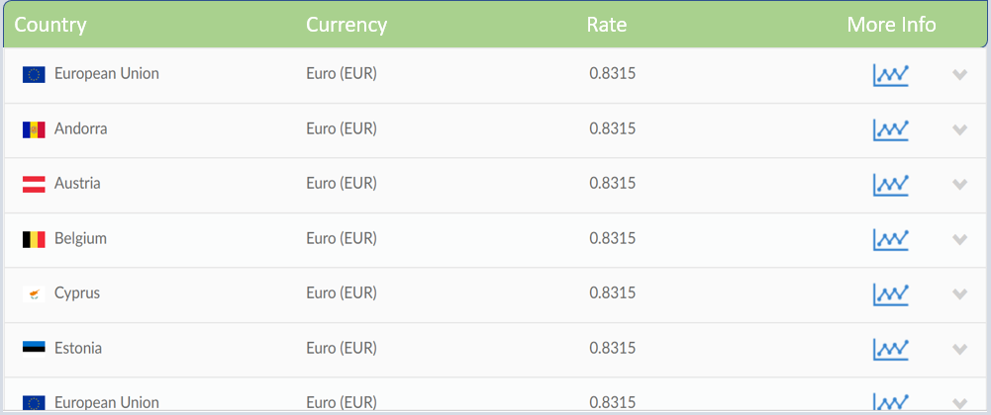
Sample UI Design:
Base Currency
Currency Conversion

Slide 13
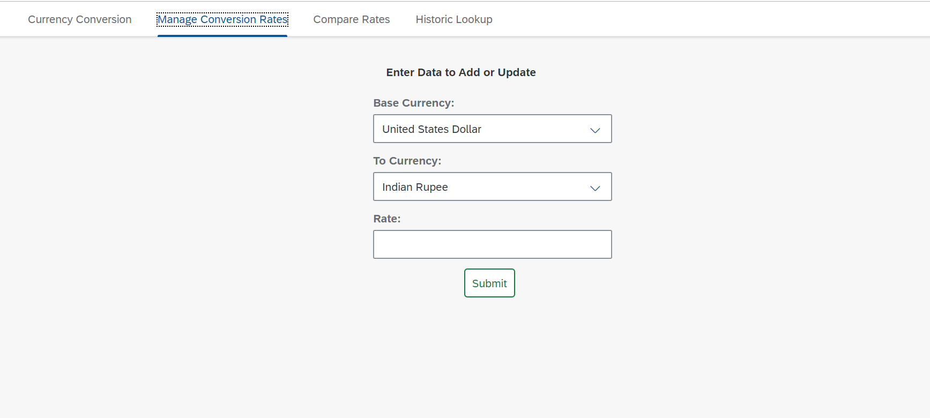

Manage Conversion Rates:
Base Cuency
To Currency
Rate
Submit

Slide 14
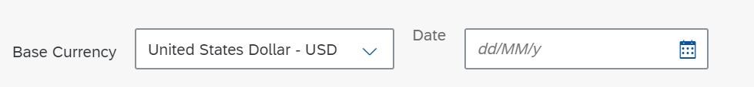
Currency | Fx Store rate | ERP Systems rate | Apps rate | Reporting applications rate

